Slide 1
Chameleon

Slide 2
Overview

Slide 3
Digital Gearheads
  Ben Carhart, David Czechowski, Mark Erikson
Mission Statement
  "To design and develop Chameleon, an adaptive Integrated Development Environment designed for instructional purposes. The goal of the Chameleon I.D.E. is to provide an environment with which an introductory computer science students can be comfortable in, and also have the ability to adapt with the student as the skill and functionality needs of the student change.”
  Basic concept: an IDE whose features and complexity can be set by the professor
  Targeted at CS 1210/1220 students (ie, students with experience ranging from none to about one year), their prof, and possibly upper-level CS students.

Slide 4
Major Features
  Text editor with syntax highlighting
  Command-line terminal connecting to a Linux server
  Code completion (start typing a word, the editor brings up possible endings)
  Debugger
  Basic project handling
  The ability for the professor to enable each of these separately
Other Requirements
  Must run under Windows
  File IO for files on the Linux server
  Terminal’s goal is to give students exposure to Linux

Slide 5
Design
Overview

Slide 6
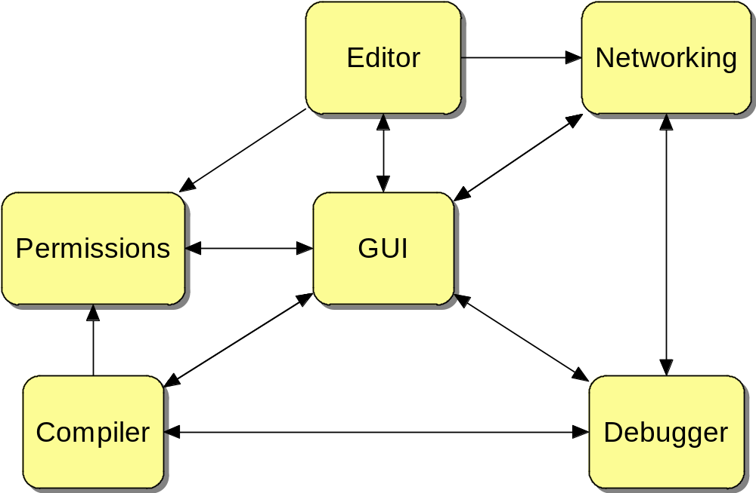

Slide 7
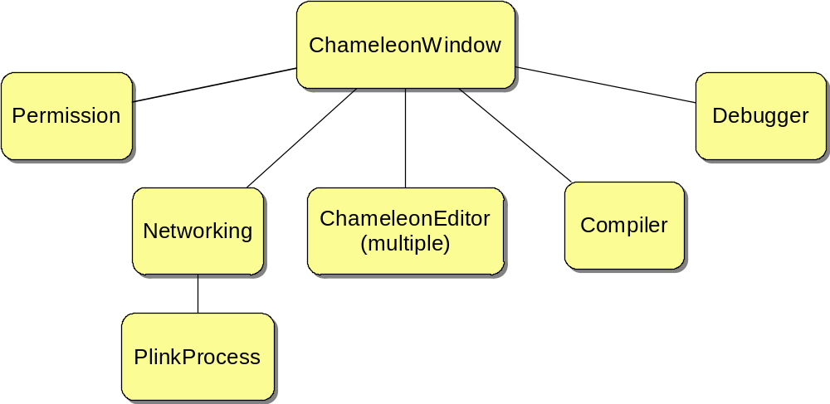
Hierarchical Ownership

Slide 8
Off-the-shelf Components
wxWindows GUI Toolkit
Scintilla Editor Widgets for syntax highlighting, code completion, etc
PLink for Server Communications
PScp for file transfer
GNU Debugger
taTelnet for terminal within GUI
GNU Compiler Collection
Code swiped from several related open-source projects

Slide 9
Design

Slide 10
Ch_Network:
Contains:
PlinkConnect ssh_plink
wxString Hostname, Username, Password(?)
wxString presentWorkingDirectory
bool isConnected
bool keepAlive
Calls:
(none)
Called:
getIsConnected < GUI
getRemoteDirListing < GUI
getRemoteFile < Editor
putRemoteFile < Editor
ssh_SendCommand < Debugger / GUI / Editor
ssh_Connect < GUI
ssh_Disconnect < GUI

Slide 11
Ch_Compiler:
Contains:
C_Network net
wxStringArray files
bool isLocal
Calls:
getPerms --to--> Permissions Manager
Called:
getFileListing < GUI
addFile < GUI
removeFile < GUI
isCompiled < GUI
startCompile < GUI

Slide 12
ChameleonWindow:
Contains:
ChameleonEditor m_currentEd (one for each open file)
wxTerminal m_terminal
Permission m_perms
CH_Network m_network
CH_Compiler m_compiler
OptionsDialog m_optionsDialog
Calls:
Permission status -> Permission
Host information > Network
Load/save files > Editor
Connection > Network
Get file listing > Network
Project management > Compiler
Enable/disable options > Everyone
Called:
(none)
Does:
Instantiates everything / serves as the main application
Handles permission interfacing

Slide 13
ChameleonEditor:
Contains:
wxString filename
Calls:
Load/save remote file > Network
Called:
Feature enable/disable < GUI
IsModified < GUI
LoadFile < GUI
Un/Re-do < GUI
Debugging display < Debugger
Does:
Handles all user text input
Auto-completion
Auto-indent
Syntax highlighting
Each is responsible for its own loading/saving

Slide 14
Debugger:
Contains:
Calls:
IsCompiled > Compiler
Compiled Information > Compiler
File Location > Editor
Debugging display > Editor
Called:
Debug Activation < GUI
Debug commands < GUI
Does:
Standard debugging on entered program
Line – by – Line Debugging
Runtime variable contents

Slide 15
Permissions :
Contains:
bitset authorized
bitset enabled
wxArrayString permNames
Calls:
(none)
Called:
isEnabled < Everyone
isAuthorized < GUI
getPermName < GUI
enable/disable < GUI
get/set < GUI
Does:
Keeps track of the visibility of modules in Chameleon
Maintains an “authorized” and an “enabled” status.

Slide 16
Status
Tasks

Slide 17
Gantt chart

Slide 18
Completed Tasks (>95%)
Compiler - Submodeling
Networking - Research - Exec / threading samples
Networking - PlinkProcess -- wxProcess wrapper
Documentation - PMP and SCMP Documents
Documentation - SRD v1.0
Documentation - SRD v2.0
Documentation - SDD v1.0
Documentation - SDD v2.0 (draft 2)
GUI - Basic dynamic windows
10/27 Presentation
12/04 Presentation
GUI – Submodeling
Editor - Multiple file editing
Debugger – Research
Debugger – d/l MinGW
Permissions – Code Perm. Manager

Slide 19
Future Tasks
Editor - Clipboard functions
Editor - Code folding
Editor - Auto-indent
Editor - Auto completion
Editor - Printing
GUI - Options dialog
GUI - Professor options
GUI - Tabbed interfaces - editor, terminal
GUI - Project management UI
GUI - Advanced dynamic windows
GUI - Debugger Graphics
GUI - Local / remote mode management
Compiler - local wxProcess compilation
Compiler - Output Redirection
Compiler - remote compliation
Compiler - Multiple Files
Compiler - GUI interface for Proj. Managment
Compiler - Automated Compilation
Networking - Direcoty Listing
Networking - Flow Chart Network Interactions
Networking - File Transfer
Networking - Network GUI
Permissions - Prof features editor
Debugger - MinGW Familiarity
Debugger - Wrapper Creation
Debugger - Identify Signals Needed
Debugger - Communication Program
Debugger - Sending Signals
Debugger - Receive Signals
Debugger - Class-ify
Debugger - Header File Creation
Debugger - Adjust
Debugger - Code creation
Debugger - Debug
Debugger - Perfection
Debugger - Compiler Coordination
Debugger - Local / Remote Switching
Debugger - Bring into GUI

Slide 20
Status
Analysis

Slide 21
GUI – 60-ish% complete
  Embedded Terminal
Editor - 35% complete
  Open & Save local files
  Syntax Highlighting
Networking - 70% complete
  Basic Networking Complete
  Sending commands and catching output

Slide 22
Compiler - 5% complete
  Depends too much on Networking
  Relatively little to do
Permissions - 95% complete
  Client-side relatively integrated
  Correctly maintains authorize / status variables
Debugger - 5% complete
  Initial research / program acquisition complete

Slide 23
Dr. Shomper says...
Are you ahead, behind, or on schedule?
Are your present or future tasks well-defined?
Did any tasks need refinement?
Have you re-allocated any resources to a difficult problem area?
Have you encountered anything you did not anticipate?
How did you overcome any surprises?
Are you keeping your documents current?
Are you maintaining your team’s meeting schedule?

Slide 24
Status
Risks

Slide 25
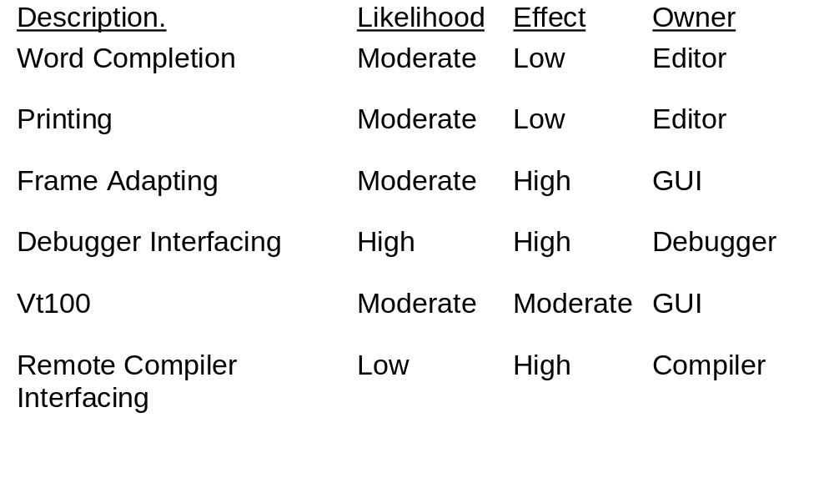

Slide 26
Demo Time!

